Slide 1

Water Tank Monitoring System
“Save Water Save Life”
Group Hitsuraan😂
Rangie Laurente
Judilyn But-anon
Mary Jane Paller
Grace Laborada

Slide 2
Abstract
To monitor the level of water in the tank, the team made a model named Water Tank Monitoring System that helps to reduce water wastage.
Using Soil Moisture Sensor and Laser Transmitter Sensor.

Slide 3
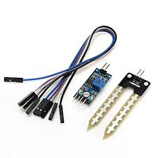

Sensors

Slide 4




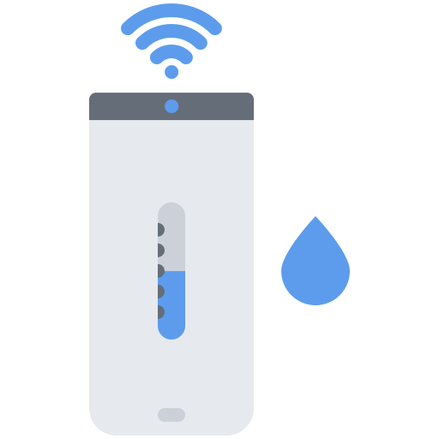


System Overview
Ok Thanks!
FULL!

Slide 5
Scope
Only capable for python and linux
Detect water level depends on what level of the tank you placed the sensor.
Send every data detected by the sensor to the user.
See the data through web or the UI
Controlled through the web or UI.

Slide 6
Limitations
Need Larger Storage
Need internet connection

Slide 7
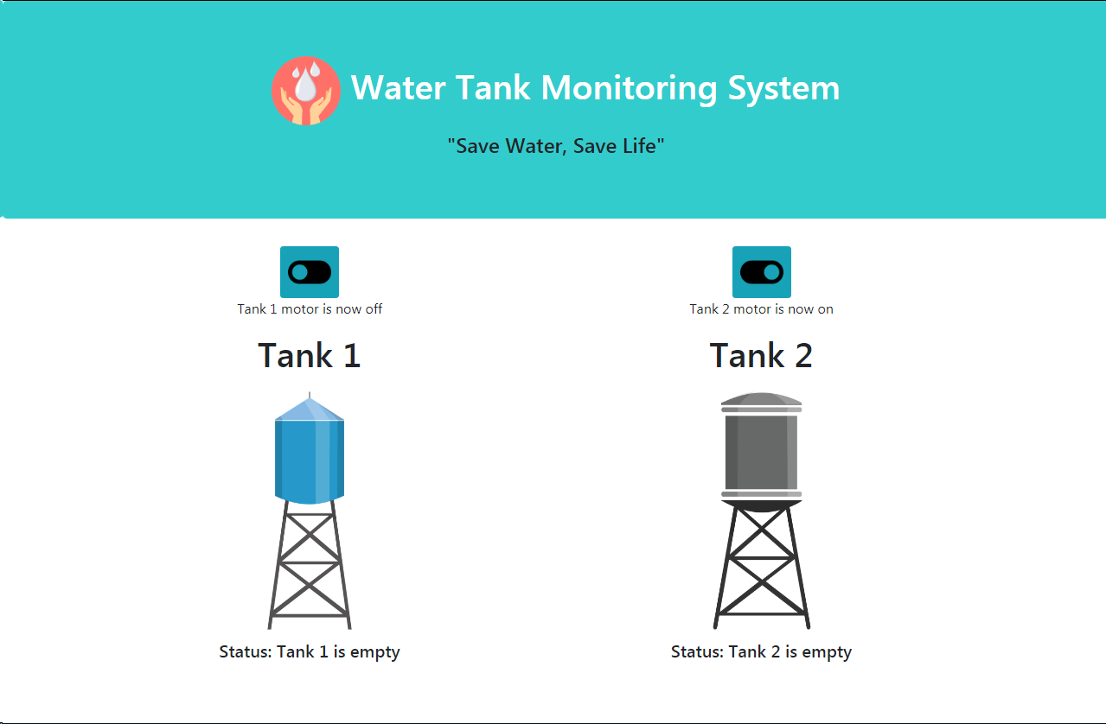
Systems Functions

Slide 8
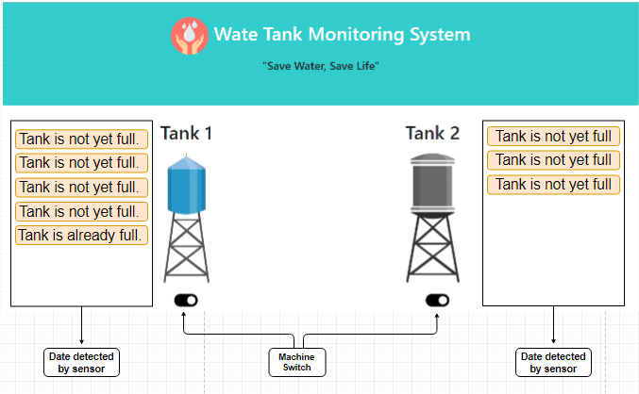

System Architecture and design
Moisture Sensor
Send and receive data
USER
Rp3
User Interface
Laser transmitter
Tank

Slide 9

DEMO

Slide 10
Thanks!
Any questions?

